Slide 1


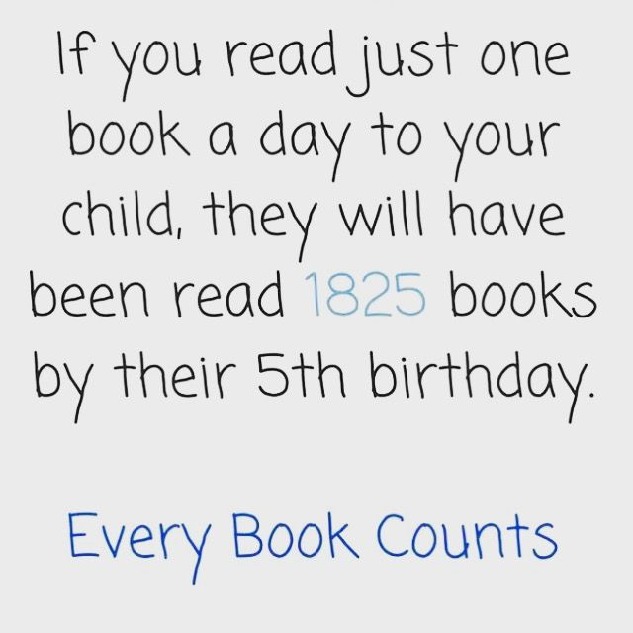
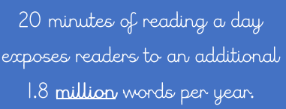
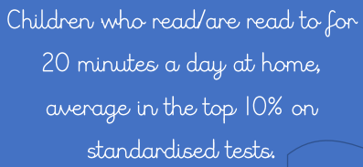
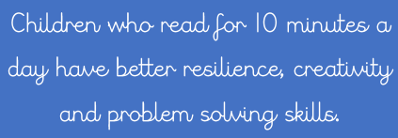

Y1 Phonics Workshop
Hagley Primary School
27th February 2025

Slide 2

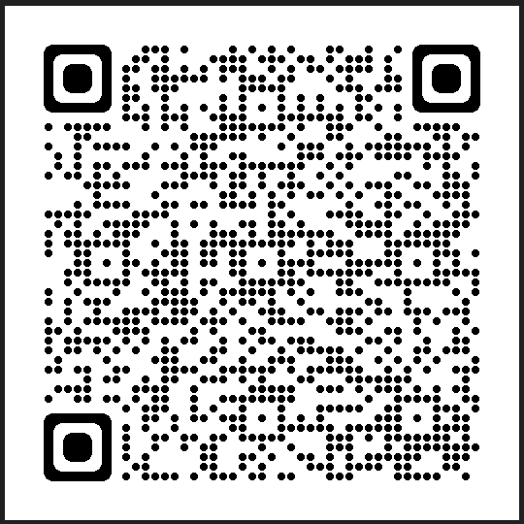
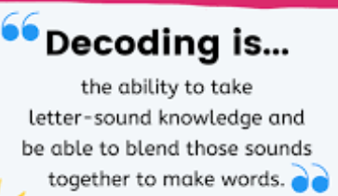
Reading
Reading for pleasure- crucial to support your child’s enjoyment of reading and setting them up for the future. This is an area of focus for us as a school and we have lots of new initiatives to support your children. Book Talk books.
Reading also sparks imagination, creativity, and empathy, nurturing essential qualities in your child’s early years. The importance of reading in Year 1 extends far beyond the classroom, it influences various aspects of a child’s cognitive, emotional, and social growth.
In school reading: we teach decoding, segmenting and blending, comprehension and expression (reading like a reader-story tellers voice)
Fluency develops as the children gain confidence and understanding of what they are reading. Re-reading is key to ensure they develop the ability to read many words at a glance.
We track reading progress through RWI phonic assessments every half term, NFER reading tests are used in Spring and Summer terms and Year 1 Phonic Screening check Week beginning 9th June. NB children do not necessarily move on every half term.
It is essential that children read daily as if they fall behind at this stage it becomes increasingly difficult to close the gap.

Slide 3
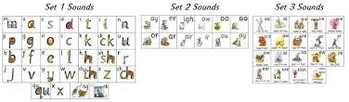
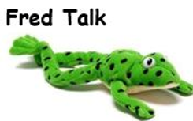


What is Phonics?
Letter sounds initially, then letter names
Pure sound, not schwa- adding u to the pure sound
Terminology: (words you will hear in the classroom today)
Fred talk
Fred in your head (blending to read)
Fred fingers (segmenting to write)
Red words (tricky words): they, want, are, some, your
Special friends (digraphs/trigraphs)
Magnet eyes

Slide 4
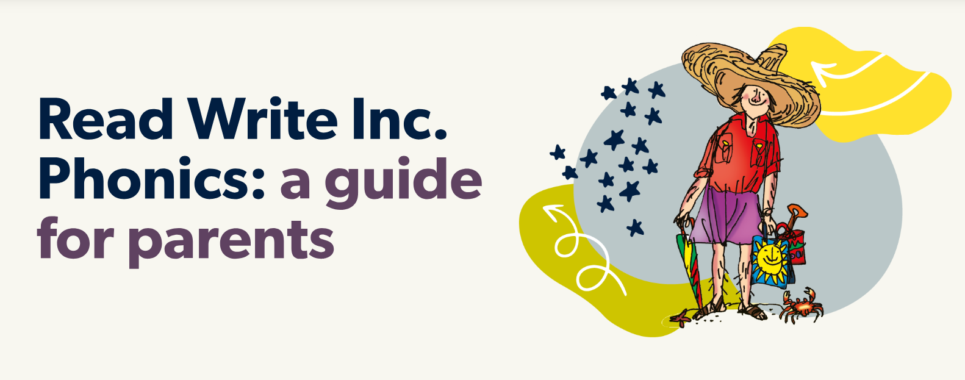
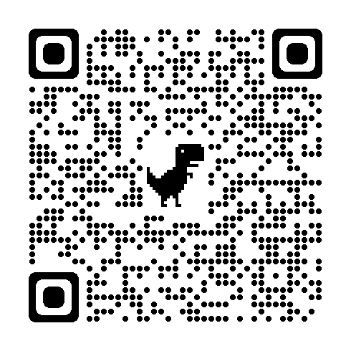
How do we teach phonics?
We follow the Read Write Inc published scheme.
Children are grouped according to their knowledge of sounds, their ability to segment and blend both real and alien words with these known sounds in and their ability to read a selection of speedy words.
As they become more competent readers they are also assessed on their fluency- how many words they can read in a minute.
There are six groups in year one to cater for the variety of individual needs.
All groups follow the same format therefore if children change groups, they are familiar with the routines and can just slot in.

Slide 5
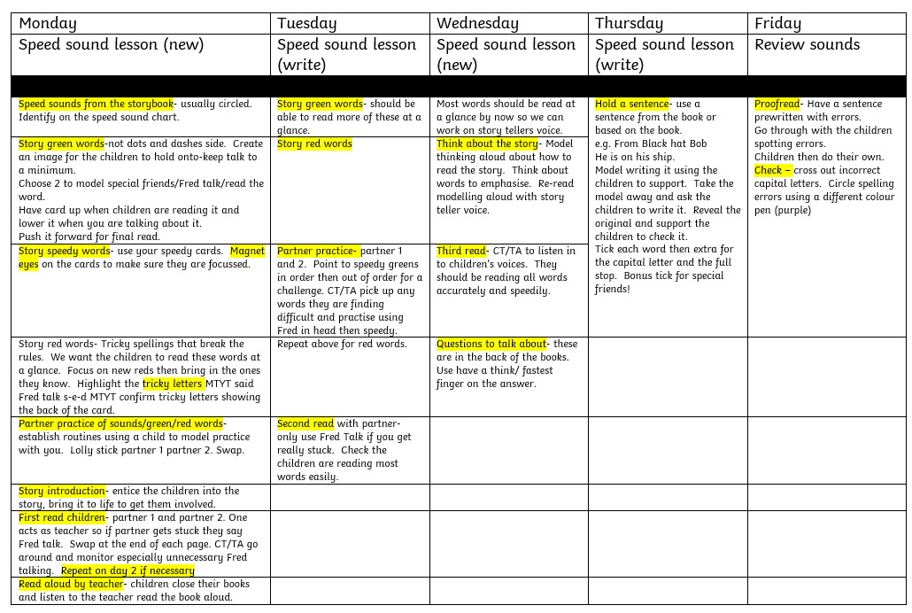
Weekly phonics timetable
Speed sound lesson
Reading focus part

Slide 6
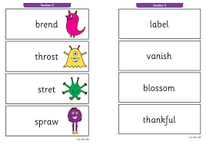
Phonic Screening Check
All children will be assessed in the phonics screening check- week beginning 9th June
One-to-one with class teacher
40 words in total split into two parts.
There are a mixture of real and pseudo (made up/alien) words.
The pass mark has been 32 out of 40 since the check was introduced in 2012.
If children do not achieve the expected standard in Y1 they will receive continued phonic support in Y2 and will re-take the check in 2026.
Passing the phonic screening check does not necessarily mean that your child will be working at age related expectations in reading as this is only one element of their reading ability.

Slide 7

What can you do to help?
Read every day with your child, little and often is better than not at all.
Complete the home learning/flashcards sent- look out for QR codes to practise real and alien words.
Use the resources you will make today to practise alien words- these are often more challenging for children.
Practise spotting digraphs in both school reading and library books.
Make sure your children’s books are in school every day.
Have fun!
Let’s have some fun in the classroom!

